Slide 1

EverSuite Training
Part 4

Slide 2
This training course
Training Goals:
Understand EverSuite Case Management Capabilities
Be able to create quickly an EverSuite Case Management application.

Slide 3
Agenda
Overview EverSuite Case Management
Building a case Study
Conclusion

Slide 4
Why Case Management ?
EverSuite Case Management is used to manage documents in workflows.
Requests move from one actor to another through the baskets.
The traffic rules are managed by processes.

Slide 5
Eversuite Case Management
  Create and Setup process to work on documents
  Create and setup Actors (users / roles) that will have to work on documents during the process live cycle
  Create and Setup baskets to allow actors to access documents to work on.
  Works on documents

Slide 6
Eversuite Case Management – Deploy
Make sure that the profiles are working.
-By going to Datasource -> Relational By Profile.
-To deploy the profiles:
-Go to the profile application
-Configuration -> Parameters -> prfStartService value should be changed to true.
-Validate , then restart the application.
-Configuration -> Initialize et.prf -> Deploy
2- Go to Case Management -> Configuration -> Parameters -> Deploy
3- Go to the homepage -> Services -> Demo Deployment (deploy the three module: Basic Structure ...)
4- Go to Case Management -> Configuration:
-Import Requests
-Import Estimates
5- Now let's create a menu for the insert mode.
-Menu URL: url:ShowPage?UseFM=yes&Template=Records/frmRecordsInsert.htm&DBName=dPortal&TableName=EDEVIS&ContextParams=R.ProfileURI=esprf:///dPortal/EDEVIS/;R.ProfileContext=CFS,CreateDemandManually,PRIORITY=,TYPE=;R.SERVICENAME=CFS;R.ServicesList=cfs&UseFM=yes&ServiceName=CFS

Slide 7
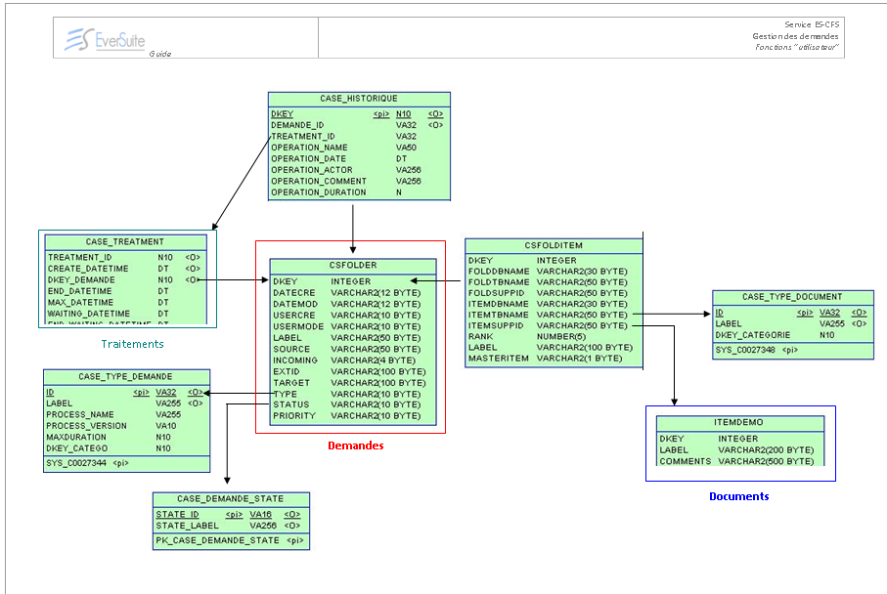
Tables - Eversuite Case Management

Slide 8
Tables Relation - Eversuite Case Management
The table JBPM_PROCESSINSTANCE (field : ROOTTOKEN_) is linked to the table JBPM_TASKINSTANCE (field: TOKEN_).
The table JBPM_TASKINSTANCE (field : ESRCODE_) is linked to the table CASE_TREATMENT (field : DKEY).
The table CASE_TREATMENT (field : DEMAND_KEY) is linked to the table CSFOLDER (field: DKEY).
The table CSFOLDER (field : DKEY) is linked to the table CSFOLDITEM (field : FOLDSUPPID).
The table CSFOLDITEM (field : ITEMSUPPID) is linked to the table Master Document (field : DKEY).

Slide 9
Agenda
End of fourth Day
Any questions?

